Slide 1
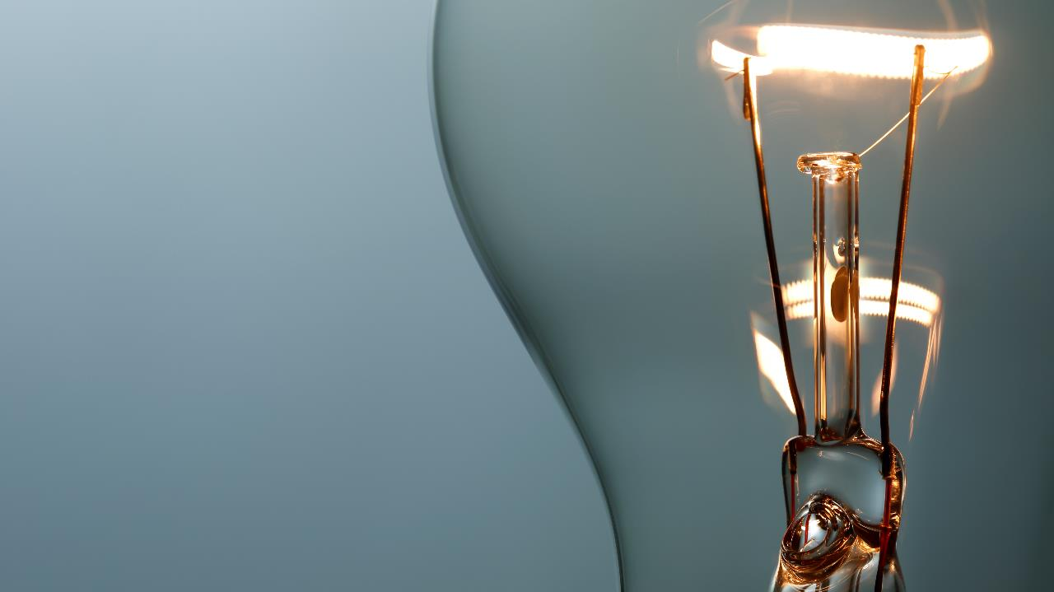
台灣會館【大家來開講】
手持電子產品介紹教學 & 數據安全

Slide 2
台灣會館【大家來開講】 手持電子產品介紹教學 & 數據安全 主講：美國宜蘭同鄉會會長 林振成(Richard Lin)
時間：6月27日（週一）下午1點 地點：台灣會館(137-44 Northern Blvd. Flushing, NY 11354) 林振成 (Richard Lin) - IT 技術、辦公室自動化、 網頁託管/設計

Slide 3
Handheld Devices Introduction and Data Security 手持電子產品介紹教學 & 數據安全 - By Richard Lin
I. 手持電子設備介紹 Handheld Devices Introduction
II. 手持電子設備設置,備份及還原
Handheld Devices Setup, Backup and Restore
III. 通訊軟體平台 Communication
IV. 雲端系統 Local Cloud System

Slide 4
Handheld Devices Introduction and Data Security 手持電子產品介紹教學 & 數據安全 - By Richard Lin
I. 手持電子設備介紹Handheld Devices Introduction
I.1 手機Cellphone (iOS, Android, Windows)
I.2 平板Tablet (iOS, Windows, Android)
iPad 9 (10.2 inches), iPad Air 3 (10.5 inches), iPad Pro (10.5 inches)
iPad (9th generation) - Technical Specifications
iPad Air (3rd generation) - Technical Specifications
iPad Pro (10.5-inch) - Technical Specifications
I.3 筆記型電腦Laptop (Windows, Linux (Redhat, Fedora 36), iOS)

Slide 5
Handheld Devices Introduction and Data Security 手持電子產品介紹教學 & 數據安全 - By Richard Lin
電池壽命Battery Life
Lithium-ion batteries have between 300-500 full charge cycles, which means you can go from a completely dead battery to a 100 percent charged one only 300-500 times,
Running your iPad down to zero before you plug it in to charge also stresses the battery, according to Hamilton. Keeping the battery neutral at the happy medium of 25-85% is your best bet for battery health.

Slide 6
Turn down your screen brightness, turn off Bluetooth or Wi-Fi if you are not using it and use less energy
Using a knock-off charger can cause an iPad to not charge properly, and lead to the battery possibly eroding
Delete un-used apps
If you have not used an app in the past month, you are probably better off deleting it. In addition to draining your battery, some apps might take it a step further - here are some apps that people might be using to spy on you

Slide 7
exposing your iPad to excessive temperatures
Low power mode is your friend - use it! Power saving options will help reduce unnecessary battery usage, which will prevent you from having to replace the battery
Wi-Fi provides much more consistency to the battery rather than using data from a cellular network, which can be a lot more stressful for your battery.
Most of us have used our iPads to read in the bathtub, or left them in the bathroom while we took a shower.
Using a screen protector or case
iPads are regularly dropped, and even if they have no surface cracks, a good knock can dislodge important connectors or shock the LCD into a black mode,

Slide 8
Handheld Devices Introduction and Data Security 手持電子產品介紹教學 & 數據安全 - By Richard Lin
II. 手持電子設備設置,備份及還原 Handheld Devices Setup, Backup and Restore
II.1 密碼安全 Password Safety
Any Financial site should need password which was not saved in the device and needs other devices to confirm password change
II.1.1 Email Phishing, MessagePhishing
II.1.2 Stay safe from cybersecurity threats

Slide 9
Handheld Devices Introduction and Data Security 手持電子產品介紹教學 & 數據安全 - By Richard Lin
II.2 網路及數據連接 Internet and Cellular Data Connection
II.3 備份及還原 Backup and Restore
II.3.1 iTune on PC - Backup to your PC
1, After connecting iPad thr USB port.
2, Start iTune, it will Sync iPad to Backup Storage.
3, Or you can select other choices to Backup or Restore your iPad.

Slide 10
Handheld Devices Introduction and Data Security 手持電子產品介紹教學 & 數據安全 - By Richard Lin
II.3.2 Local Cloud System
II.3.2.1 Western Digital myCloud App
1, Open MyCloud App
2, View Shares
3, View Camera Roll Backup

Slide 11
Handheld Devices Introduction and Data Security 手持電子產品介紹教學 & 數據安全 - By Richard Lin
II.3.2.2 Western Digital myCloud.com
myCloud.com (Can be on Internet)
A, My Cloud (mycloud.com)
B, for others to view and download
My Cloud selected files or directories for others
C, Admin
Local: http://WdMyCloudEX4100 will be mapped to:
https://device-local-ba25d156-3776-4a12-b3fa-9404208f443c.remotewd.com:8543/
Out of Office:http://wdmycloudex4100.wtc.net/

Slide 12
Handheld Devices Introduction and Data Security 手持電子產品介紹教學 & 數據安全 - By Richard Lin
II.3.2.3 Seagate GoFlex_Home
II.4 應用程式商店 App Store
II.4.1 Facebook, Line, WeChat, ApplePay, Bank App, Paypal,
II.4.2 Zelle (Free Transfer within the same bank), Cash App

Slide 13
Handheld Devices Introduction and Data Security 手持電子產品介紹教學 & 數據安全 - By Richard Lin
III. 通訊軟體平台Communication
III.1 手持電子設備和 PC，文件結構Handheld Devices and PC, File Structure Apple File Structure File Structure Top File Structure One Step Down

Slide 14
Handheld Devices Introduction and Data Security 手持電子產品介紹教學 & 數據安全 - By Richard Lin
III.1.1 iTune on PC, PhotoTransferApp (on PC and Handheld)
III.2 手持電子設備之間的通信Between Handheld Devices
III.2.1 AirDrop - to Photos of the other devices
III.2.2 DropBox - If the attached file is out-of- limited-size
(Valid in limited time frame - two weeks)

Slide 15
Handheld Devices Introduction and Data Security 手持電子產品介紹教學 & 數據安全 - By Richard Lin
III.3 手持電子設備和周邊設備 Handheld Devices and Peripherals
III.3.1 智能電視 Smart TV (wireless, USB-c to HDMI)
III.3.2 網絡印表機Network Printer (with AirPrint)
III.3.3 Apple Watch, OBD-II Scanner
III.3.4 OBD-II Scanner for iOS
Limitation

Slide 16
Handheld Devices Introduction and Data Security 手持電子產品介紹教學 & 數據安全 - By Richard Lin
IV. 雲端系統 Local Cloud System
IV.1 Seagate GoFlex_Home 網路儲存系統
IV.2 Western Digital myCloud.com 網路儲存系統

Slide 17
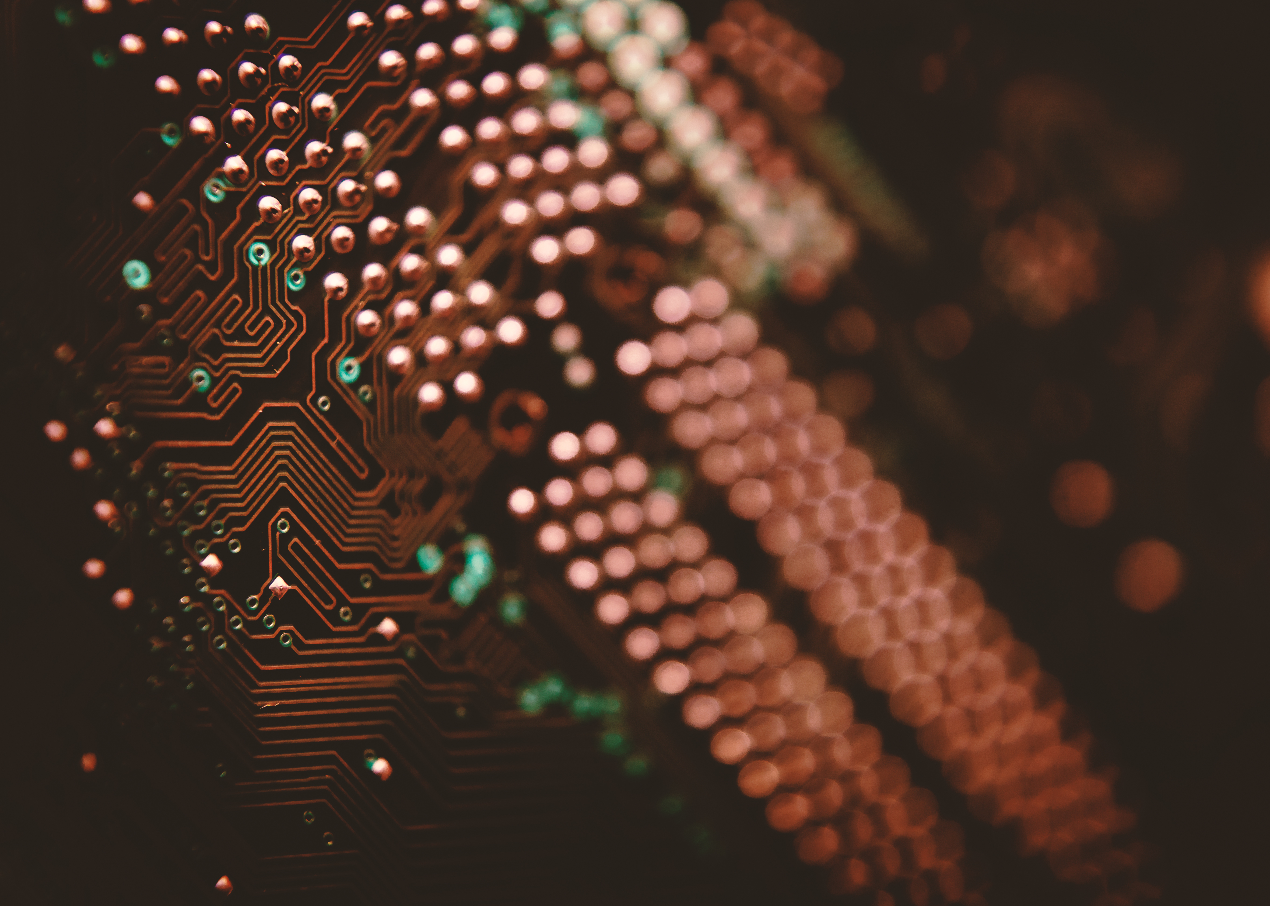
Computing Components
NETWORK
PROCESSOR
CLOUD COMPUTING
SERVER

Slide 18
Distribution

Slide 19
Process
Access needed
Determine scale
Select technology

Slide 20
Contact details
someone@example.com

